Slide 1

Bug Bytes
Polus Banyameen, Maria Leon, Sydney Lum, Steven Mondoux

Slide 2


Project Details
Bug Bytes is a website that allows a user to learn java with the help of an ape companion. It will provide users with guides, lessons, and questions that will help them work on their first programming fundamentals, such as variables and writing basic functions. It will offer multiple-choice, matching and fill in the blank questions. Each lesson is designed to be entertaining and informational, with each lesson escalating accordingly.

Slide 3
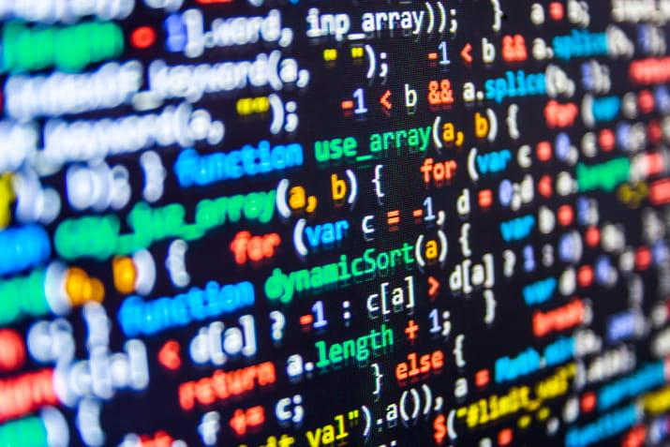
Lessons & Question Types
We plan on having four question types:
Multiple choice questions - Where user can select one of 4 options
Fill in the blank - Either have a blank input box or a drop down with prewritten words.
Matching - a bank of options with a bank of questions users can match
Short Code - Allows the user to upload a java file and run in the backend where we can check the output of the code
Lessons: So far plan on having installing requirements, basic variables, syntex, data types, for/while loops, and more

Slide 4
Account Creation
Progression will be saved on an account, specific to each user. The information will be stored in a database using MySQL to keep track of points collected, correct answers, and items purchased.
With each lesson completed, a new ape is found!
The user-chosen ape will accompany the user along their lesson progression.
Shop feature:
The more a user plays, the more points they will accumulate
Users can buy cosmetics and skins for their ape

Slide 5

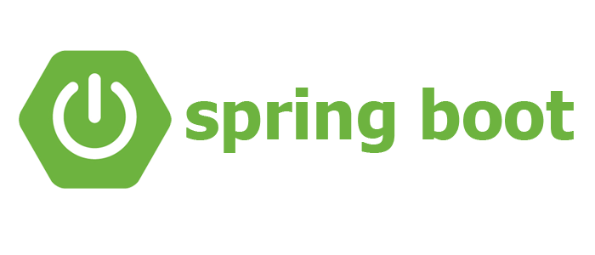

Technology Used
MySQL - Open-Source Relational Database Management System
Used to store user information and progression
Spring Boot - Java framework for web applications
Used to help build the web application
HTML/CSS - frontend aesthetics
Javascript - Allows our frontend to be dynamic
Apache Maven - Build automation tool for Java
Used for running the server
GroupMe + Google Meets - Communication
GitHub - Sharing Code between members
IntelliJ IDEA & VS Code - writing and compiling code

Slide 6
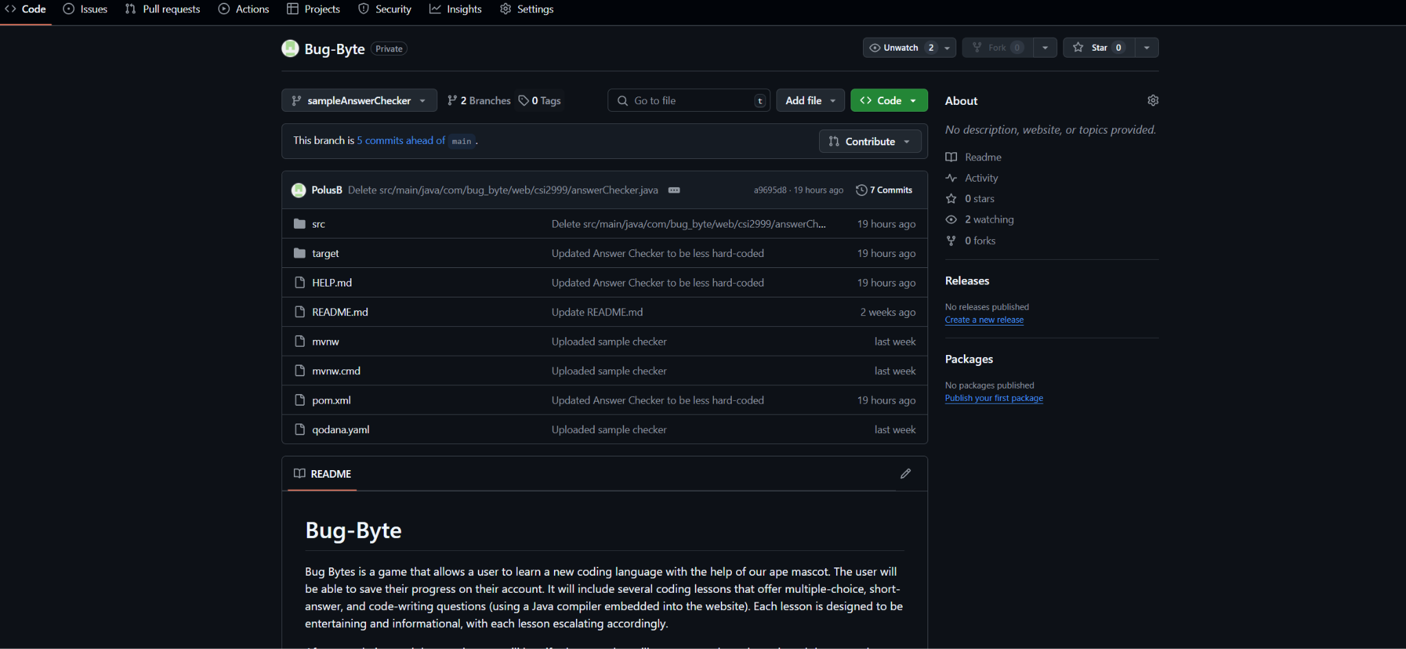
What’s working so far
Got our first API working functional. This API checks the answer the user selected and sends it to the backend to check whether it is correct. It then confers with our MySQL database and checks whether the question is correct or not and then sends a response.
We have documented and have all required technologies ready to download
We have our GitHub ready and linked so we can upload and compare code.

